Slide 1
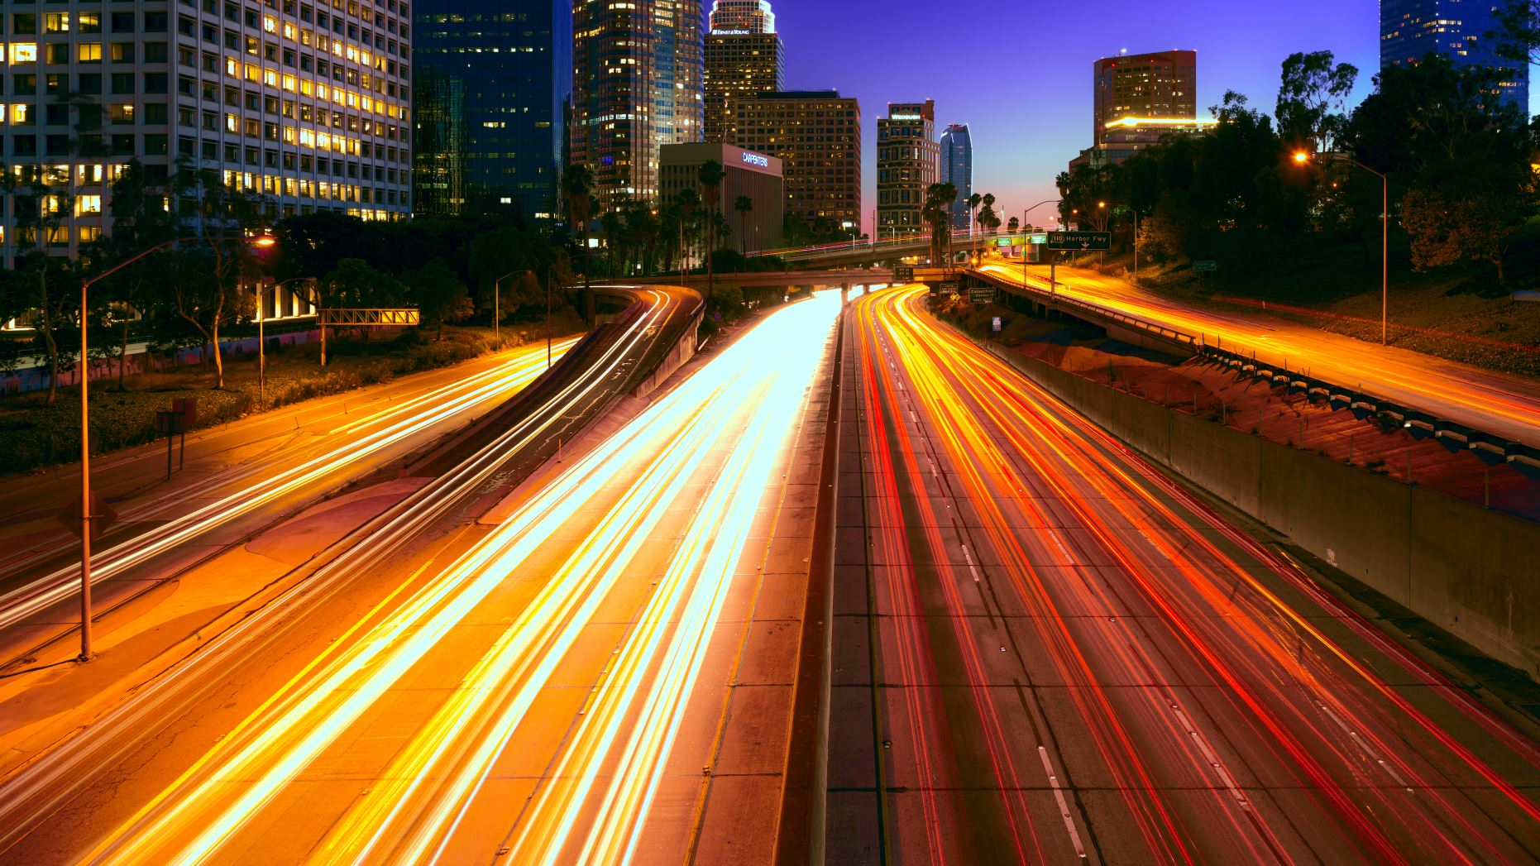
California Traffic Collision Data
By Group 2: Arin Ceniza, Fausto Vidrio, Izea Espinoza, Joel Flores, Manuela Sahagun, & Michael Do

Slide 2

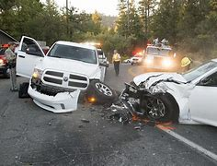
Introduction
In the year of 2021, the state of California had reported 4,161 deaths that were the result of a traffic collision.
Discussion:
Party Sobriety
Parties at fault
Types of victims involved
Data Source: https://www.kaggle.com/datasets/alexgude/california-traffic-collision-data-from-switrs

Slide 3
Data Flow Chart
Download data from kaggle data set
Create csv files using DBBrowser (SQLite)
Upload csv files to hive
Analyze data using Tableau Desktop
Download data using queries and scp
Create hive tables using hiveQL

Slide 4
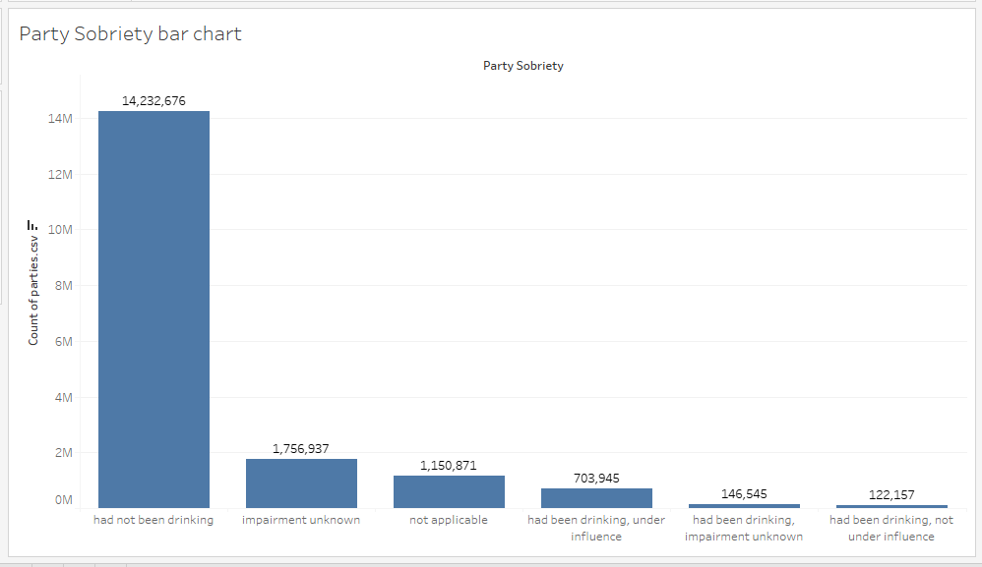
Party Sobriety
Majority of the parties had not been drinking at 14,232,676
Impairment unknown states investigators couldn’t determine party sobriety. Calculated at 1,756,937

Slide 5
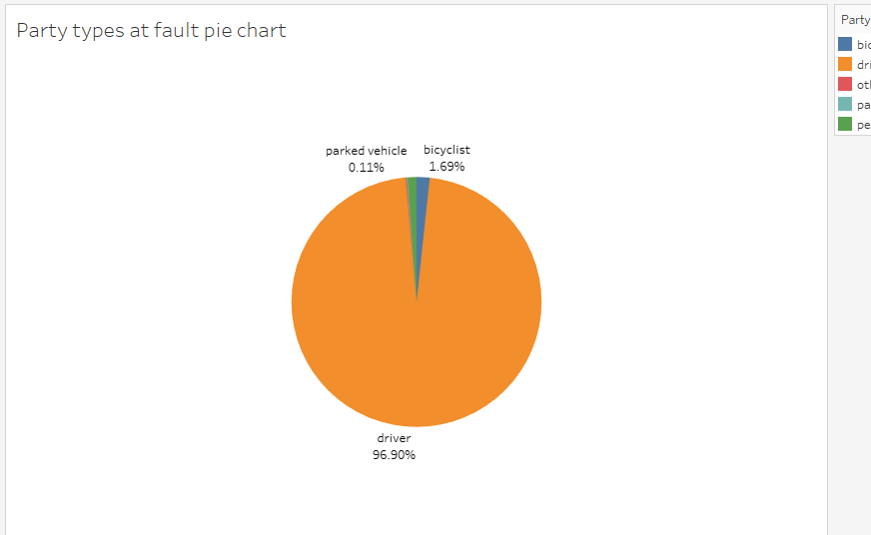
Party at fault
Drivers made up 96.90% of parties at fault.
Bicyclists made up 1.69%
Pedestrians made up 1.15%
Other was accounted for at 0.14%
Parked Vehicles made up 0.11%

Slide 6
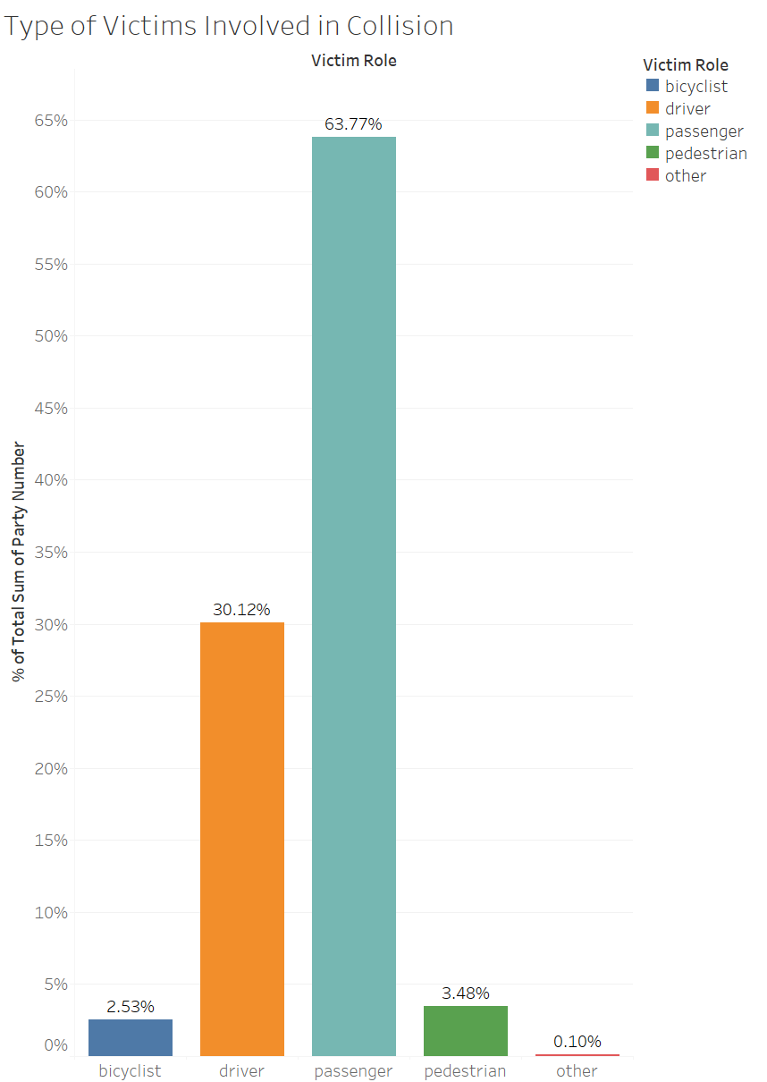
Type of Victims Involved in Collision
Total Number of Victims 1,701,805
Victims Type
Bicyclist (2.53%)
Driver (30.12%)
Passenger (63.77%)
Pedestrian (3.48%)
Other (0.10%)
Majority of the participants involved in collision resulted passenger being the victims

Slide 7
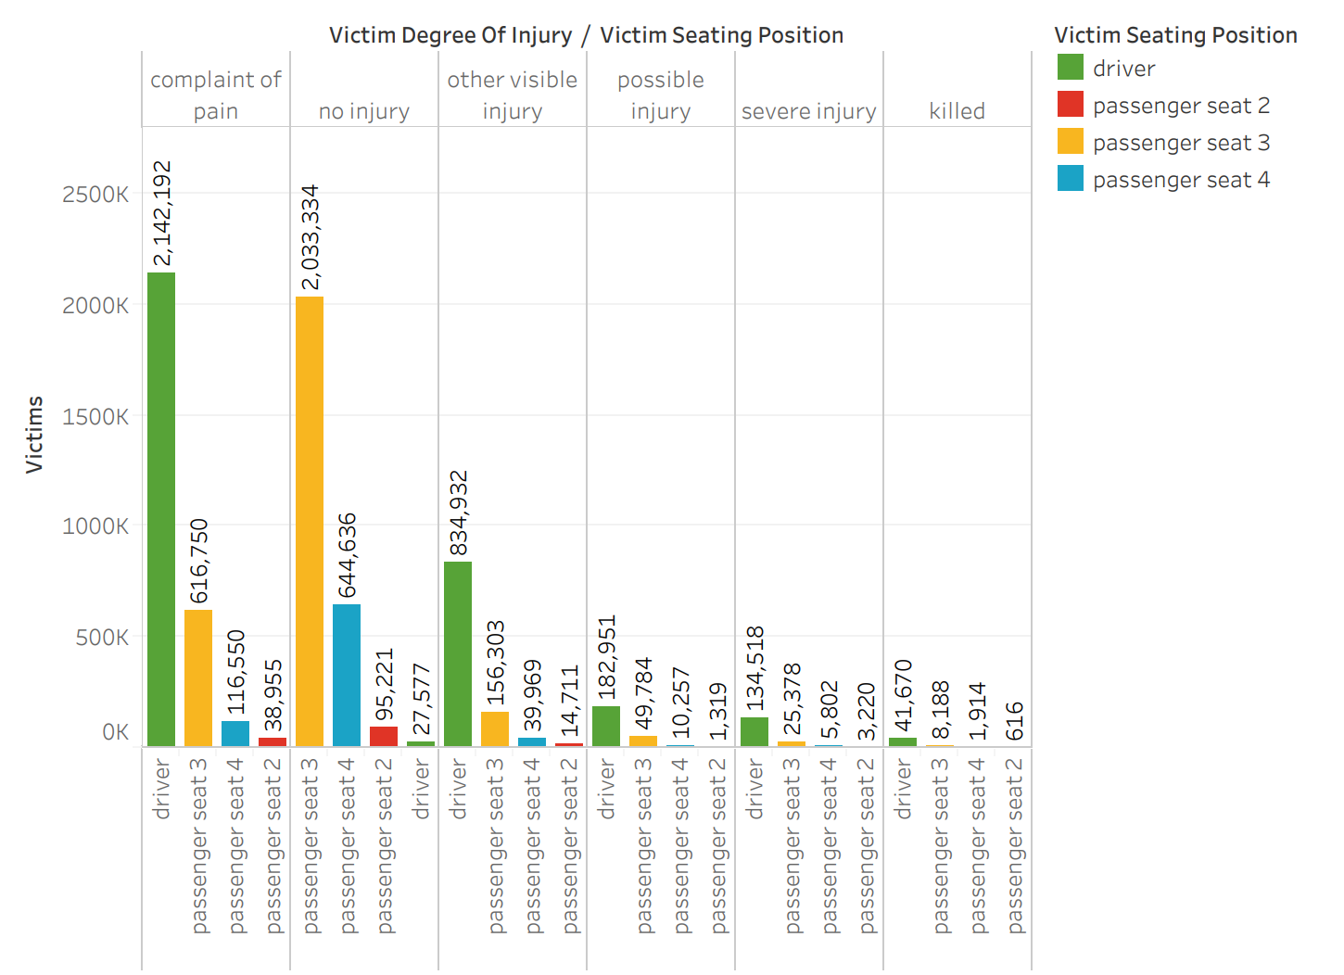
Victims Degree of Injury
2,142,192 drivers complained more of pain when involved in an incident
The driver is also the deadliest seat to be in when involved in a crash
The data shows passenger seat 3 to be the safest with a 2,033,334 victims reporting no injury

Slide 8
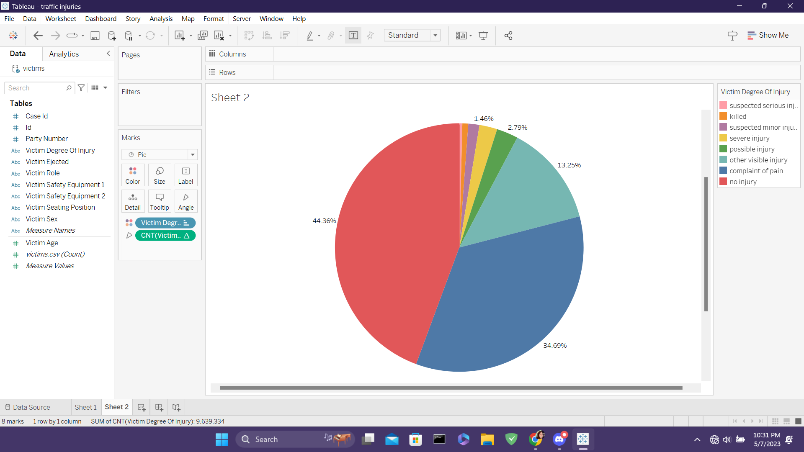
Victim Degree of Injury
Total Number of Reports: 9,639,334
The most common response is "No Injury" at 44.36%
The least common response is "Suspected Serious Injury" at 0.39%
While "Killed" is the second least common response at 0.74%, that is still 73,000 accidents per year.

Slide 9
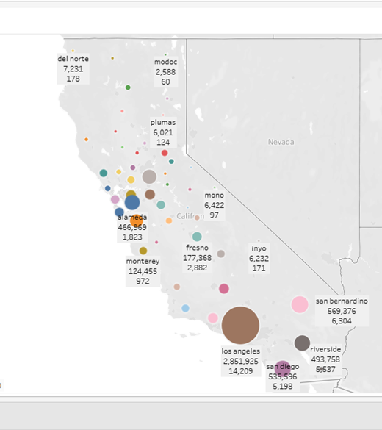




Traffic Collision by County
The Top Five Counties with Traffic Collisions
Los Angeles County – 2,851,925
San Bernardino – 569,376
San Diego – 535,596
Riverside – 493,758
Alameda – 466,969
Traffic Collisions Resulting in Fatalities
Los Angeles County – 14,209
San Diego – 6,304
Riverside – 5,537
San Bernardino – 5,198
Alameda – 1,823

Slide 10
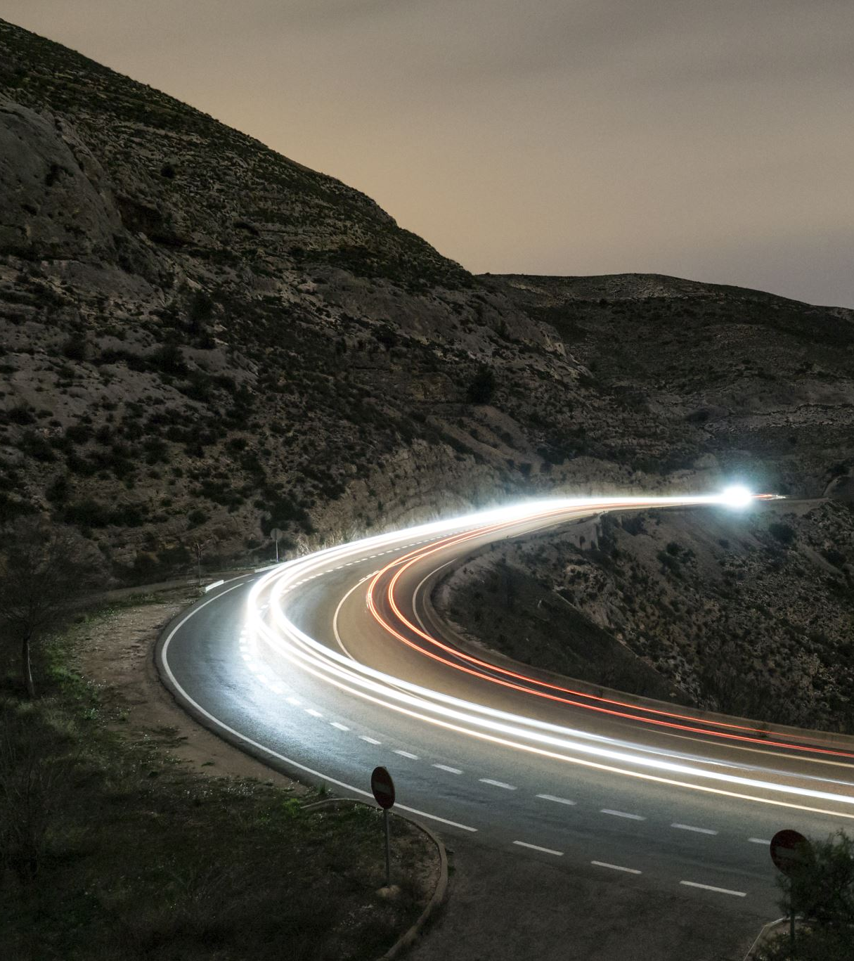
Works Cited
“California Traffic Collision Data from SWITRS.” Kaggle, https://www.kaggle.com/datasets/alexgude/california-traffic-collision-data-from-switrs. Accessed 20 March 2023.
Elflein, John. “Motor-vehicle deaths in California 2021.” Statista, 10 June 2022, https://www.statista.com/statistics/675550/motor-vehicle-deaths-california/. Accessed 6 May 2023.

